Slide 1
Strengths and Weaknesses
Marcin Kuruc

Slide 2
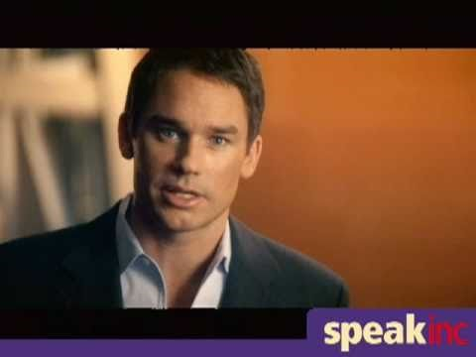
Keynote Speaker: Marcus Buckingham - Presented by SPEAK Inc.

Slide 3
Marcus Buckingham
Does society raise us to be more well-rounded or do we place emphasis on improving our strengths?
Does environment and culture play a big part on what makes us unique?

Slide 4
Knowing your personal strengths
Allows you to grow even more
Boosts your self confidence
More effective, fulfilled and successful
Knowing your personal weaknesses
It keeps you from engaging in activities where you can’t make much impact.
It provides an opportunity for others—people with the very strengths you’re missing— to contribute. This strengthens your team.
It keeps you from frustrating yourself and others.
Notes:
http://salpro.salpaus.fi/tes/CD-rom/pdf/BilSEself-assessment_en.pdf
http://www.myrkothum.com/personal-strengths-and-weaknesses/
http://qdostraining.com/downloads/personality_test1.pdf

Slide 5
The “5-Minute Personality Test”
Are the results accurate based on the description of yourself?
Will your results be different if your best friend/family relative rated you?

Slide 6
Other Strength and Weakness Assessments
StrengthsFinder 2.0 – Gallup
www.strengths.gallup.com/default.aspx
Richard Step Aptitude Test
www.richardstep.com/richardstep-strengths-weaknesses-aptitude-test/

